Slide 1
Differential Equations and a few helpful ways to solve them

Slide 2
Differential Equations
In this class we will focus on solving ordinary differential equations that represent the physical processes we are interested in studying. With perhaps a few exceptions the most complicated differential equation we will look at will be second order, which means it will look something like
Sometimes you may be able to solve the equation by hand. Other times not. Here we will cover some useful methods to help you solve them as you need to.

Slide 3
SOS MATH
Great website that has so much helpful stuff on it and is pretty accessible and easy to follow, unlike so many others.
http://sosmath.com/diffeq/diffeq.html
A lot of the differential equations we are interested are solved there. I have always found it useful as it helps me learn to solve these things by hand.

Slide 4
Mathematica
As a student at Notre Dame you can download and have access to Mathematica, which is an incredibly powerful and amazing tool for solving all sorts of mathematical problems. If it cannot solve the differential equation we are looking at then it is unlikely you can either.
The specific command for solving a differential equation is
DSolve

Slide 5
Example
Solve the following differential equation in Mathematica assuming that D(x) and λ(x) are constants.
Rearrange (we will assume D is constant, but may not always be)

Slide 6
In Mathematica
Open a clean sheet
Define you equation
Type eq:=DD*C’’[x}==lambda*C[x]
Hit shift+return
Confirm it is correct
Type eq
Hit shift +Return
Solve the differential equation
Type Dsolve[eq,C,x]
Hit shift+return

Slide 7
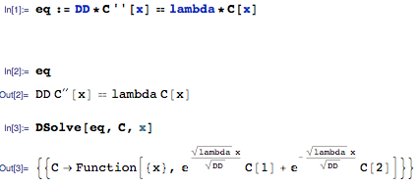
Example

Slide 8
Now you try
Solve the following differential equation

Slide 9
You can also specify boundary conditions
Solve
Subject to boundary conditions

Slide 10
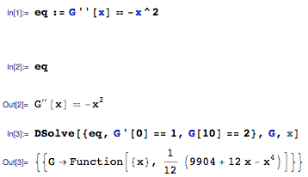
Example

Slide 11
You try
Solve
Subject to

Slide 12
OK
Now you’re in good shape to solve pretty much any of the ordinary differential equations that you will face in this class
You will have a few of these for homework just to make sure that you feel comfortable with it all.

Slide 13
Numerical Solutions
Coupled Ordinary Differential equations.
Imagine I have two (or more) concentrations that are coupled to each other such that
Plot the concentrations over 100 times units

Slide 14
Before we solve this
Look at the equations carefully.
What do you think the solution is going to look like
Do a few things
What is Steady State/Equilibrium
Where do both start, where do they end?
Draw what you think solution will look like.

Slide 15
Hopefully you remember from JJW
You can approximate the derivative by (for small Δt)
So I can write my equations as
With these I can
write a loop to solve for
C1 and C2 at whatever
time I want

Slide 16
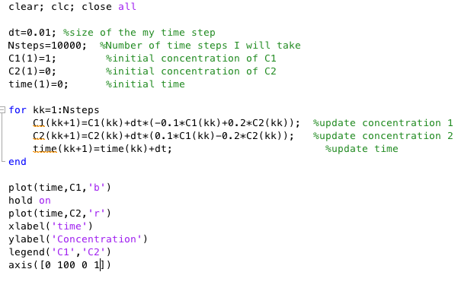

Slide 17
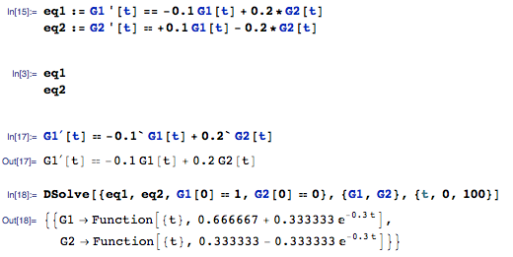
Verify this solution
With Mathematica you can easily show that the theoretical solution to this problem is

Slide 18
Ok you try this slightly harder one
Solve

Slide 19
Alternative
If you prefer not to write your own solver and use a more efficient one you can use Matlab’s inbuilt ode45 function (https://www.mathworks.com/help/matlab/ref/ode45.html)
Or
You can use the numerical solver NDSolve in Mathematics (http://reference.wolfram.com/language/tutorial/NumericalSolutionOfDifferentialEquations.html) - I do not personally love this
On the following slide I show you how to solve some of the problems we have looked at with both, but leave it to you to invest time and learn how to use them.

Slide 20
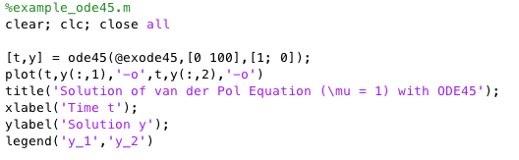
Matlab ode45

Slide 21
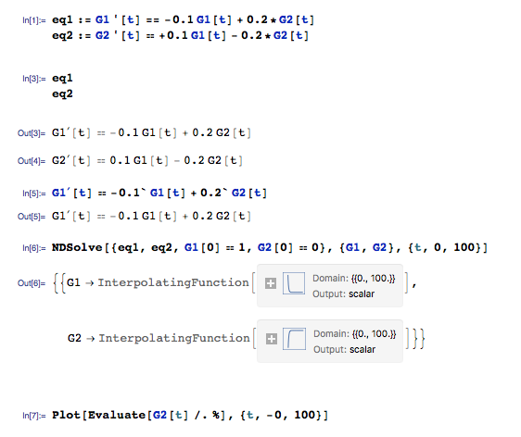
Mathematica NDSolve

